Slide 1

Teamwork Presentation
Perfecting your Final Presentation
Company Name
Watson 104: Engineering Communications
By Victoria Schutrum
Fig 1. College Study Group. (Resource Advisor, 2016)

Slide 2



Stages of a Presentation
Know your Content
Format your PowerPoint
Prepare your Information
Deliver your PowerPoint
?
Answer Questions with Confidence

Slide 3

Know Your Content
Fig 2. Content Image (Quark.com, 2018)

Slide 4
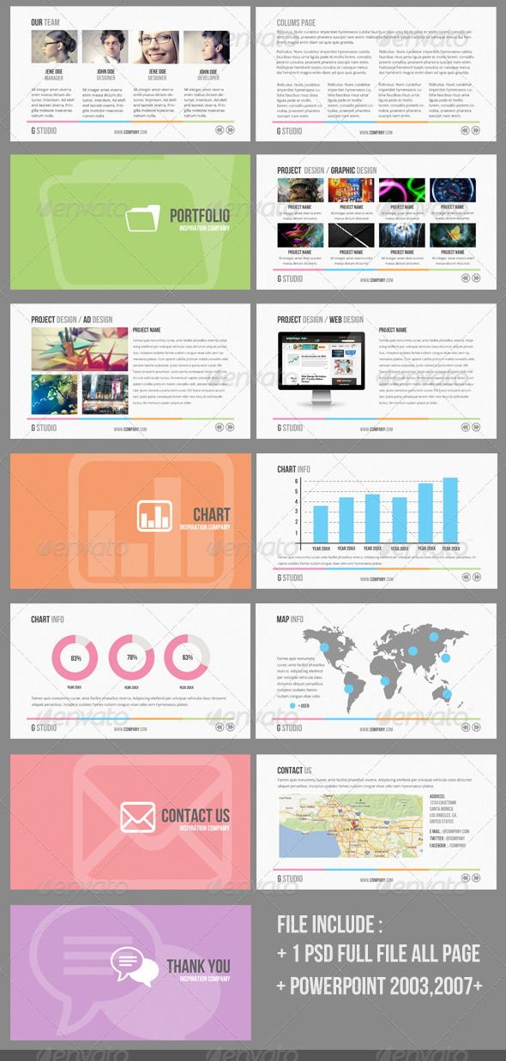
Presentation Content
Cover slide
Agenda
Design statement
Final design
Pahl and Beitz
Requirements/Verifications
Conclusion
“Thank you” slide
References
REFERENCES
Fig 3. Clean PowerPoint Presentation. (Graphicriver.net, 2018)

Slide 5

Format your PowerPoint
Fig 4. Formatting Ideas (eZ.com, 2017)

Slide 6
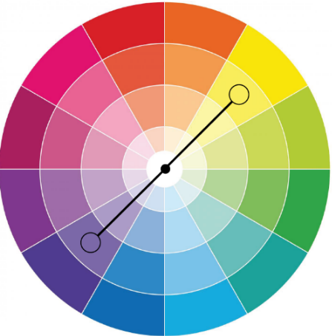
Formatting Basics
Font
Format
Headings >36 font
Body text >18 font
Avoid unconventional fonts
Use complimentary colors
Keep similar tone (formal vs casual)
Complementary Colors
Good Choices:
Arial
Century
Constantia
Georgia
Times New Roman
Poor Choices:
AR BONNIE
Blackadder ITC
Curlz MT
Freestyle Script
Jokerman
Fig 5. Color Wheel. (PicabooYearbooks.com, 2018)

Slide 7

Formatting Basics
Place most important text at top of slide
Have images on each slide
Audience understands topic of a slide at a glance
Visuals support your content
Tip: Cite all visuals in smaller print below image
Fig 6. Looking at Graphs. (Dreamstine.com, 2018)

Slide 8

Time Limitations
Keep to 15-20 minutes for entire presentation
Avoid animations- they waste crucial time
Avoid redundancies-present design details through requirements & verifications
Fig 7. Hourglass Timer. (Pngtree.com, 2018)
Minutes 1-5
~ Cover Slide
Minutes 6-8
~Requirements ~Verifications
Minutes 18-20
~Conclusion
~“Thank you”
~References
Lead into questioning
~ Agenda
~ Design Statement
Minutes 9-18
~Final Design
~Pahl and Beitz

Slide 9

Avoid Death by PowerPoint
1.
Bullet Points
2.
No Data Dumps
3.
Simple Layout
Fig 8. Death by PowerPoint. (Fppt.com, 2018)

Slide 10

1. Bullet Points
Compliment verbal presentation
Slides guide you and trigger important talking points
Prevents you from reading verbatim off slides
Maintains audience attention
Make slides attractive and not overwhelming
Quickly relay information
Fig 9. Checklist. (Springshare.com, 2017)

Slide 11
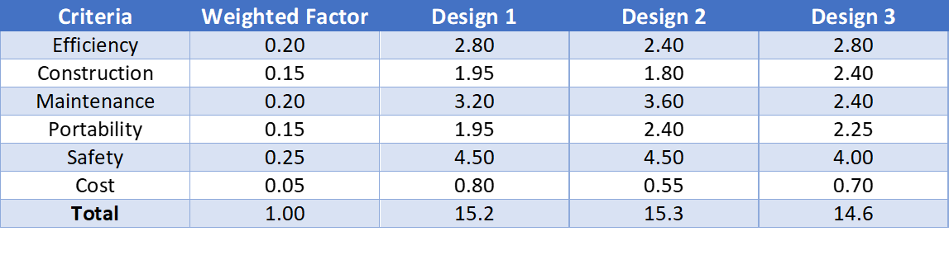
2. Avoid Data Dumps
Highlight most important data
Avoid confusing statistics and graphics
Avoid reading numbers out loud
Before
After

Slide 12

3. Simple Layout
Less is more (memorable)
Avoid complex language/graphics
Utilize PowerPoint themes
Use Smart Art for clear graphics
Fig 10. Monitoring Bar Charts. (Barewalls.com, 2016)

Slide 13
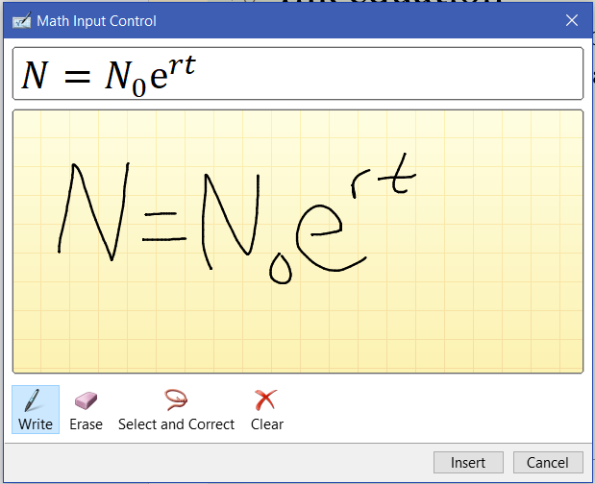

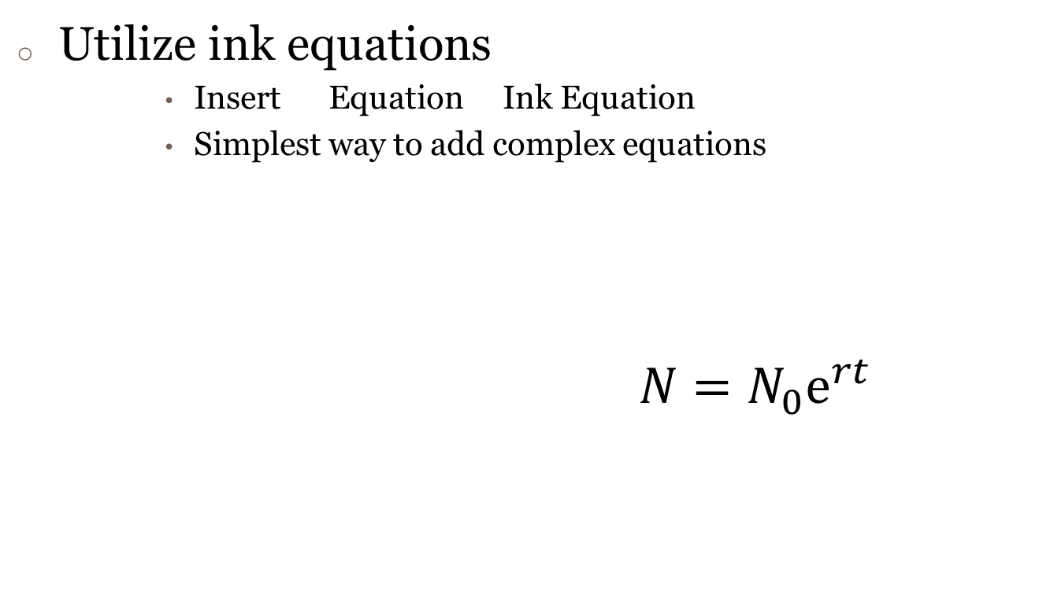
Formatting Tips
Utilize ink equations
Insert Equation Ink Equation
Simplest way to add complex equations
$N=N_{0}ⅇ^{rt}$

Slide 14

Formatting Tips
Utilize alignment
View Ruler, Gridlines, Guides
Great for aligning text boxes and graphics
Rulers
Gridlines
Horizontal guide
Vertical guide

Slide 15

Prepare your Information
Fig 11. Working on PowerPoint. (eZ.com, 2017)

Slide 16
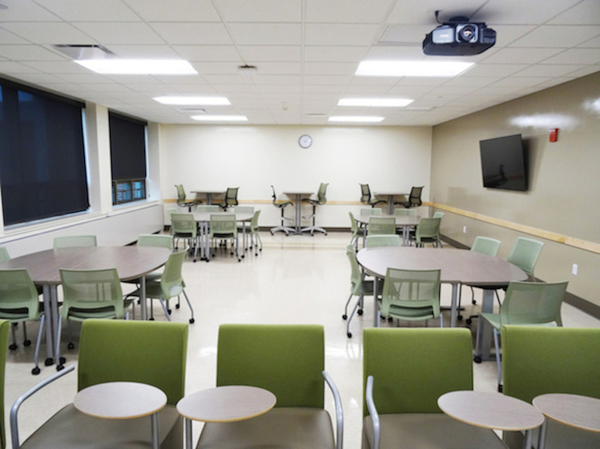
Know the Situation
Goal:
to inform and convince
Audience:
peers, UCAs, professor, CEO
Setting:
classroom, business casual
Fig 12. Binghamton Arrangement. (Binghamton.edu, 2017)

Slide 17
Prep your Slides
Create impressive slides for your ideas to be best perceived
Add speaking notes in the “notes section” of slides
Allow enough time to prepare
Practice your presentation
Evenly delegate slides to teammates

Slide 18

Practice your Presentation
As an individual
As a group
Run through the slides in front of each other with a time
With UCAs
Run through presentation in front of UCAs, take note of suggestions
Decide how to begin the presentation
Practice presenting the ideas on your slide
Remember pronunciations, definitions, and statistics without notecards
Be mindful of filler words “um, uh, so, like…”
Fig 13. Presentation. (Transparentpng.com, 2018)

Slide 19

Deliver your PowerPoint
Fig 14. Launching Ideas. (eZ.com,2017)

Slide 20

Group Presentation Tips
Memorize your slides and the order in which your teammates speak
Avoid awkward transitions between speakers
Be excited about what your group is presenting
Start with a strong, commanding introduction
Fig 15. Team. (Freepngimg.com, 2018)

Slide 21
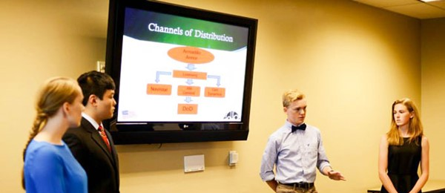
Individual Presentation Tips
Be present when your teammates are talking (do not look bored or distracted)
Step forward slightly when speaking
Gravitate toward screen when presenting
Audience should see you and the screen simultaneously
Practice moving as a team to avoid mass shuffle during presentation
Fig 16. Group Presentation. (Bullittschools.org, 2014)

Slide 22

Mannerisms to Avoid
Staring at the presentation screen
Vary your eye contact among audience members
As you scan the audience, utilize side wall screens in classrooms to trigger memory
Distracting mannerisms
Avoid fidgeting with hands, playing with hair, pacing, etc.
Looking insecure or uncomfortable
Never present with hands in your pockets
Stand upright with good posture
Do not speak too fast
Fig 17. Public Speaking Concerns. (Under30CEO.com, 2018)

Slide 23


Answer Questions with Confidence
Fig 18. Group Questions. (eZ.com, 2017)

Slide 24
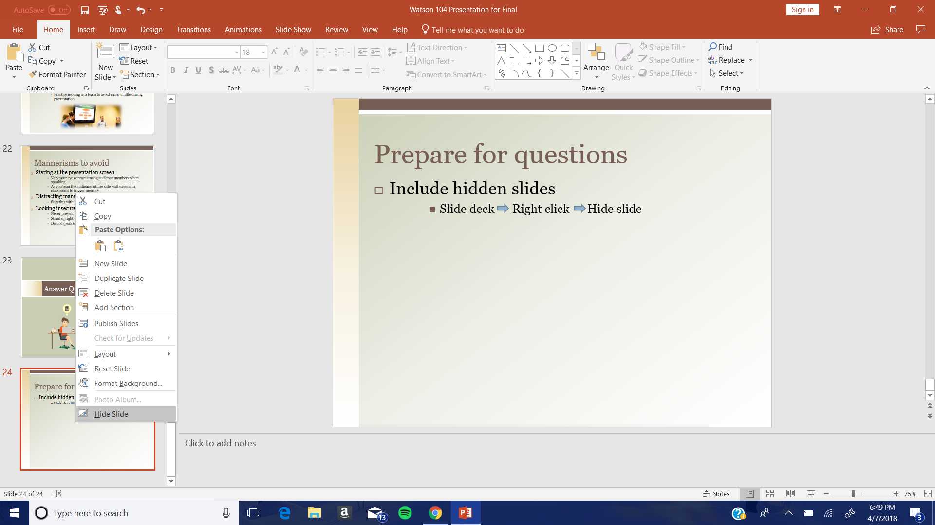
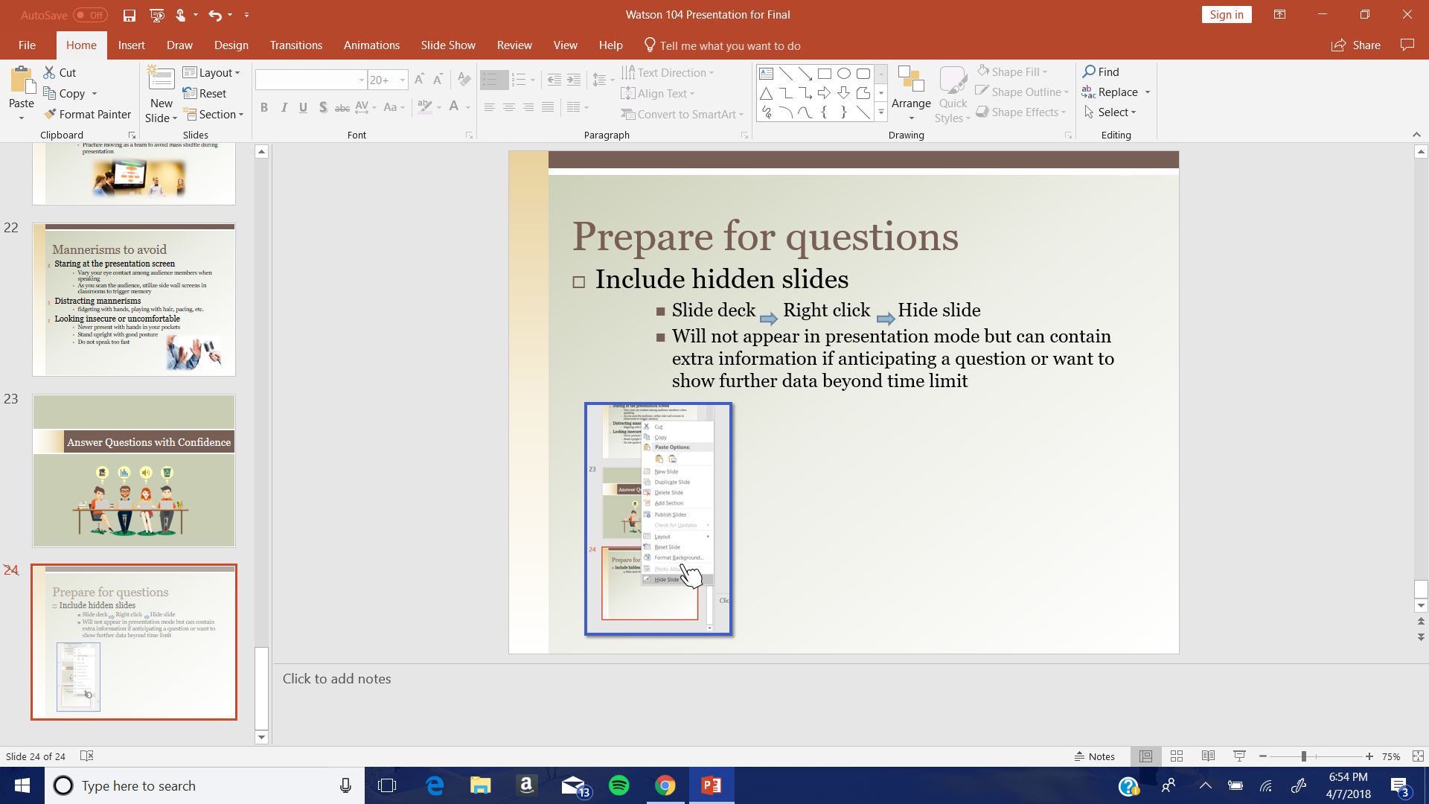
Prepare for Questions
Include hidden slides
Slide deck Right click Hide slide
Will not appear in presentation mode but can contain extra information to show further data if time allows

Slide 25

If a question challenges your work…
Always defend your work
Explain the reasoning behind your decisions to justify your work
Be respectful of criticism
Never undermine a teammate or your team’s work
Fig 19. Thought Icon (Freeiconspng.com, 2018)

Slide 26

When you don’t know the answer…
Do not lie/make something up
Do not brush the question aside
Do not give an opinion as an answer
Admit you do not know the answer but continue to address the question confidently
Fig 20. Hands Raising for Questions (Citizensinitiative.eu,2004)

Slide 27
Addressing Difficult Questions
If you do not remember the answer…
If you did not research the question…
Admit you do not feel comfortable answering question
May direct question to a teammate
If team not confident about answer, ask audience member if you could respond to them in the near future
Compliment their idea
Admit further research would have to be conducted to answer their question

Slide 28
Review
Know your content
Prepare your information
Answer questions with confidence
?
Format your PowerPoint
Deliver your PowerPoint

Slide 29
Good Luck!
Fig 21. Creative Process. (eZ.com, 2017)

Slide 30
References
Thomas J. Watson School of Engineering. (2018). WTSN 104- Engineering Communications II Spring 2018, 64-65. Binghamton University: Engineering Design Division.
Phillips, D. JP. (2014, April 14) How to avoid death by PowerPoint. Retrieved from https://www.youtube.com/watch?v=Iwpi1Lm6dFo.
Fig 1. Schneider Electric. (2016). College study group brainstorming together in classroom or library. Retrieved from http://resourceadvisor.com/blog/schneider-electric- helps-new-jersey-schools-achieve-financial-success-energy-efficiency/college-study-group-brainstorming-together-in-classroom-or-library/
Fig 2. Quark. (2018). Content Automation. Retrieved from //www.quark.com/Solutions/Content-Automation/Content-Automation-Software.aspx
Fig 3. Graphic River. (2018). Clean PowerPoint presentation template. Retrieved from https://graphicriver.net/item/clean-powerpoint-presentation-template/3569844
Fig 4. eZ Systems AS. (2017). eZ platform cloud. Retrieved from https://ez.no/Products/eZ-Platform-Cloud
Fig 5. Picaboo Yearbooks. (2018). A color theory cheat sheet. Retrieved from https://yearbooks.picaboo.com/color-theory-cheat-sheet/
Fig 6. Dreamstime. (2018). Group of businesspeople looking at graphs. Retrieved from https://www.dreamstime.com/stock-photo-group-businesspeople-looking-graphs- cropped-shot-digital-tablets-image60247618
Fig 7. Pngtree. (2017). Hourglass timer HQ pictures. Retrieved from https://pngtree.com/freepng/hourglass-timer-hq-pictures_1035474.html
Fig 8. Fppt.com. (2018). What is death by PowerPoint & how to easily avoid it. Retrieved from https://www.free-power-point-templates.com/articles/death-by-powerpoint/
Fig 9. SpringShare. (2017). Public libraries. Retrieved from https://www.springshare.com/public/
Fig 10. Barewalls.com. (2016). Art print touching stock market chart. Retrieved from https://www.barewalls.com/art-print-poster/touching-stock-market- chart_bwc18308960.html
Fig 11. eZ Systems AS. (2017). eZ connectors & add-ons. Retrieved from https://ez.no/Products/eZ-Connectors-Add-Ons
Fig 12. Binghamton University. (2017). Student wing classroom 114. Retrieved from https://www.binghamton.edu/clt/ecc/classrooms/classimages/SW%20114%20- %20back.JPG
Fig 13. TransparentPNG. (2018). Presentation. Retrieved from http://www.transparentpng.com/cats/presentation-242.html
Fig 14. eZ Systems AS. (2017). eZ platform enterprise edition. Retrieved from https://ez.no/Products/eZ-Platform-Enterprise-Edition
Fig 15. Free PNG img. (2018). Team. Retrieved from http://www.freepngimg.com/png/18830-team-free-download-png
Fig 16. Bullitt County Public Schools. (2014). Galley photo. Retrieved from http://www.bullittschools.org/DistrictGallery.aspx?CategoryId=40516&schoolid=0
Fig 17. Under 30 CEO. (2018). A breakdown of 5 fundamental presentation skills. Retrieved from http://under30ceo.com/a-breakdown-of-5-fundamental-presentation- skills/
Fig 18. eZ Systems AS. (2017). Product Personalization. Retrieved from https://ez.no/Products/eZ-Personalization
Fig 19. Free Icons PNG. (2018). 3D question mark blue icon. Retrieved from https://www.freeiconspng.com/img/41634
Fig 20. Citizens Initiative. (2004). Who is going to launch an ECI on which issue. Retrieved from http://www.citizens-initiative.eu/who-is-going-to-launch-an-eci-on-which- issue/
Fig 21. eZ Systems AS. (2017). eZ platform enterprise edition. Retrieved from https://ez.no/Products/eZ-Platform-Enterprise-Edition

